Slide 1

Whether the government should increase investment in helping drug addicts reintegrate into society?
袁梦瑶

Slide 2
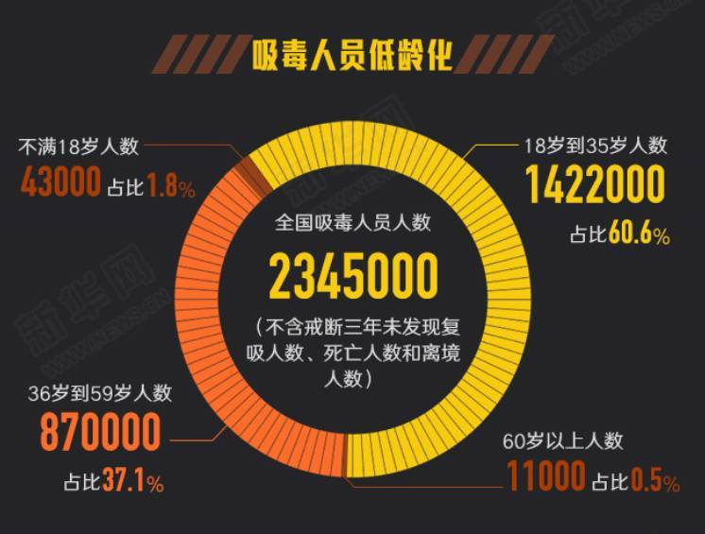
The drug user group is getting younger
Data
This set of statistical data was released in 2021.
Among the current number of drug addicts in our country, those aged 18-35 accounted for 60.6%.

Slide 3
CONTENTS
01
The direction and achievements of our government's current drug rehabilitation funds.
Ruturn to the society
02
The impact of increased investment in helping addicts return to society.

Slide 4
01
PART ONE
Direction and achievements

Slide 5
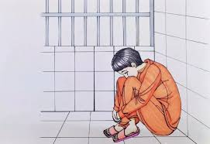

Main measures
traditional therapy
Through compulsory detoxification, drug substitution therapy and psychological intervention.
The self-harm and suicide rates of addicts have greatly increased.
surgical detoxification
High-risk :wound infection and even cerebral hemorrhage
side effects : reduced attention to surrounding things, laziness, and reduced communications

Slide 6
Reult
According to a survey by the China Drug Rehabilitation Institute, the relapse rate has reached 90%.
INVESTMENT
RETURN
90%
relapse rate

Slide 7
02
PART TWO
Impact

Slide 8
History of the legalization of drugs in Portugal.
Result:
The number of drug users has fallen by half
The number of drug-related crimes fallen sharply(from 104 cases per million to just three in the official data.)
Background:
In the 1980s ,drug users were everywhere in Portugal.
01
02
03
04
The Portuguese government’s solution:
change the perception of the masses.
pays them half of their wages for six months after they are rehabilitated

Slide 9
SUMMERY
&
Q&A

